Slide 1
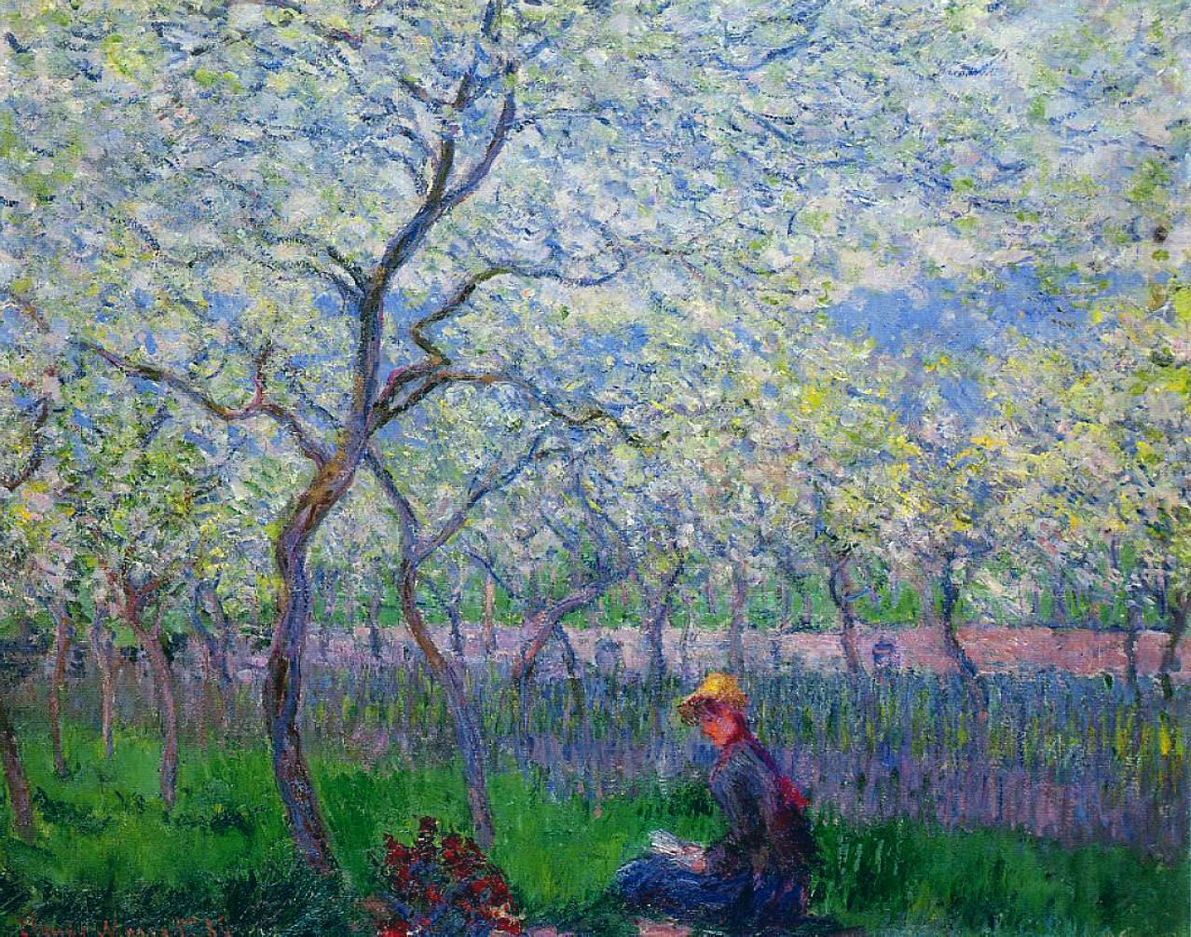


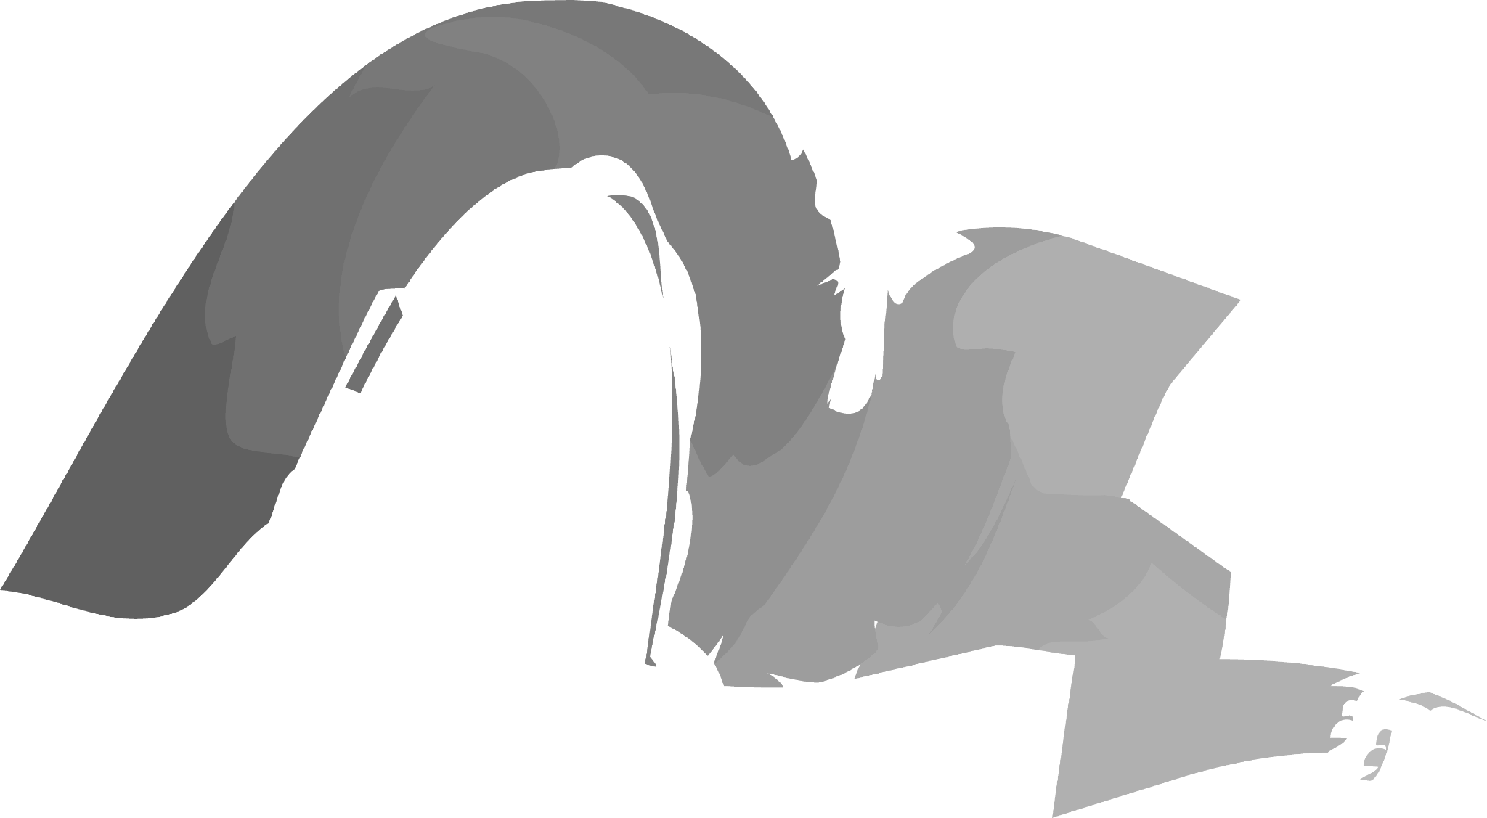
Snob
Stopper
Grant Gordon, Riccardo Maffei

Slide 2
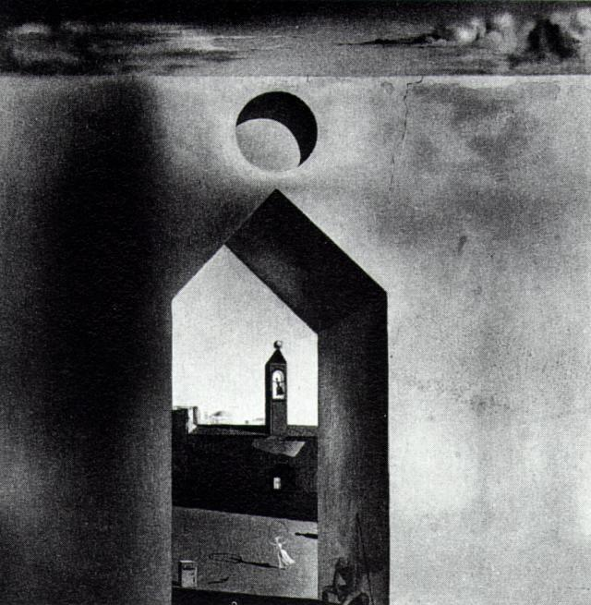
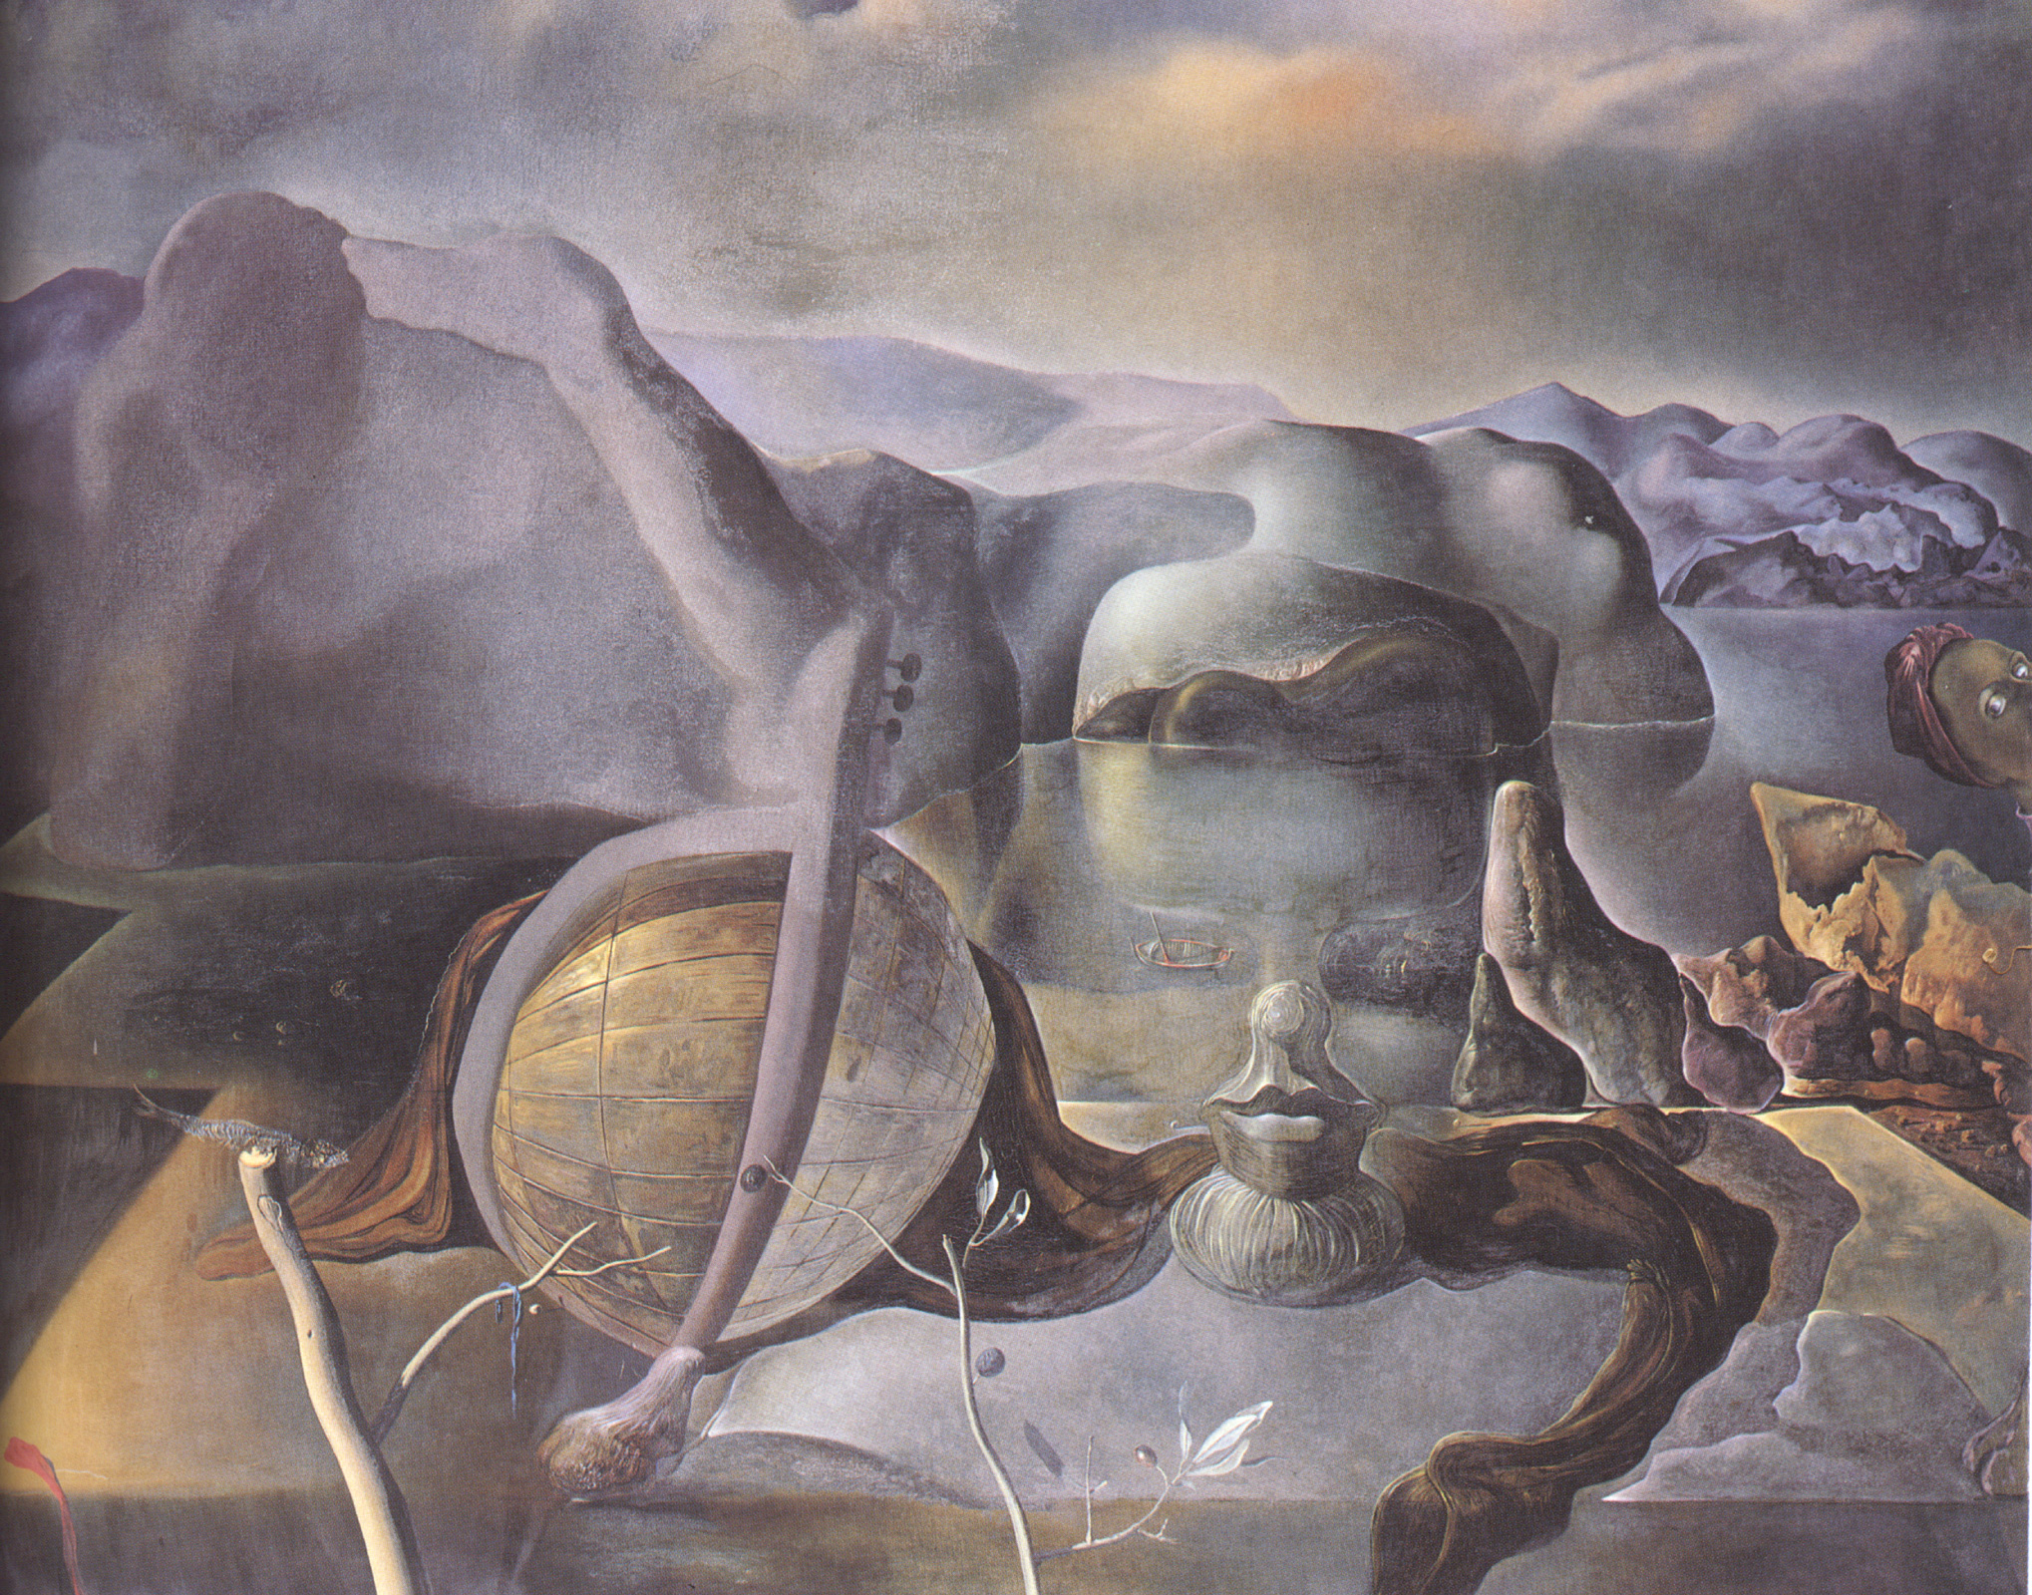
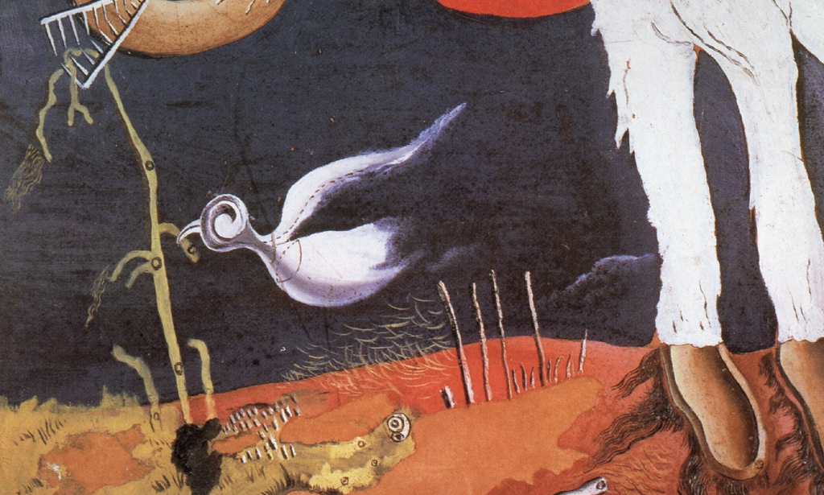
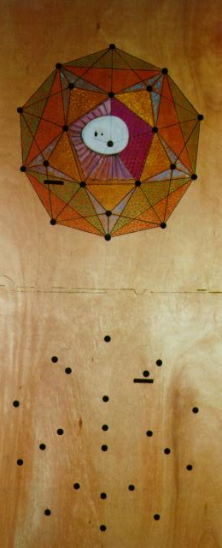
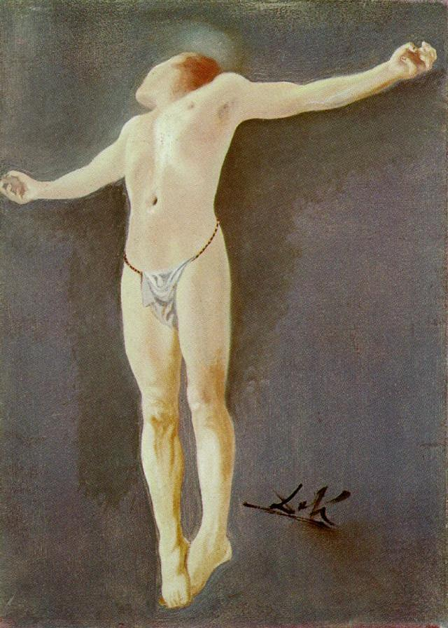
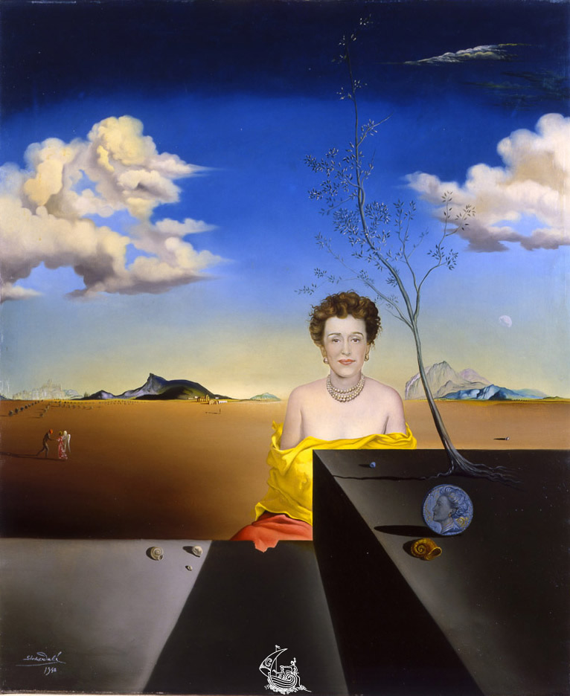
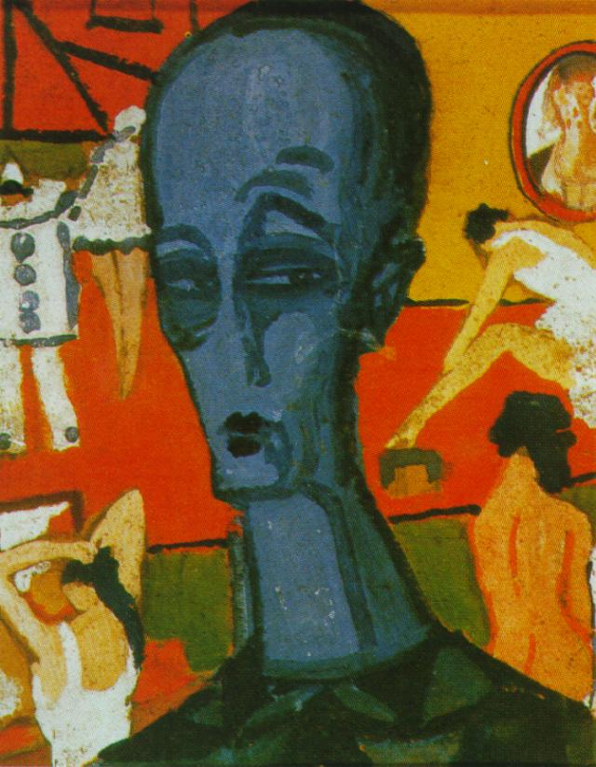
Find the Dali

Slide 3
Find the Dali

Slide 4
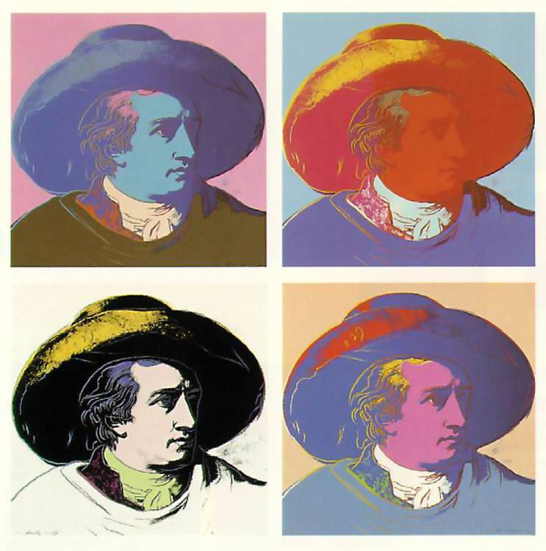
Artist Identification Made Easy
Silence the snobs with your Tech superiority
Average of 45% accuracy
Currently recognizes:
* Monet
* Van Gogh
* Dali
* Rembrandt
* Warhol
* DaVinci
* Renoir
* Degras
* Picasso
* Munch

Slide 5
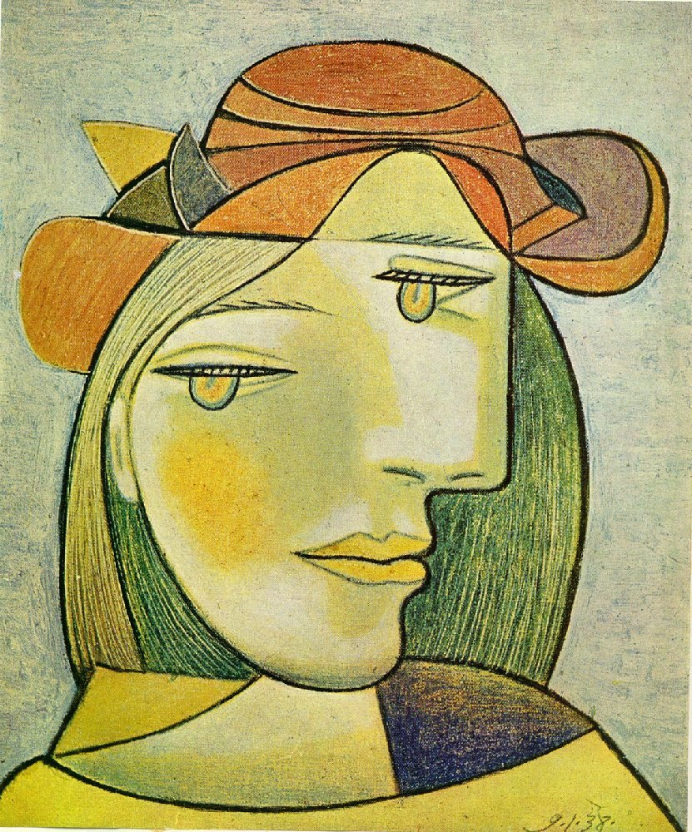
Data Collection

Slide 6
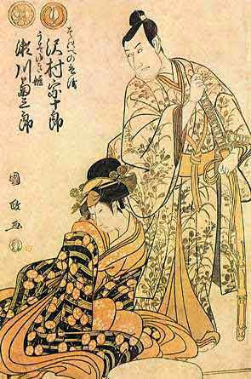
Connecting to API’s
First attempt was connecting to Museums APis which ran into many issues
Artists have a surprising amount of works
Paywalls or “Required Donations”
Museums only listed their collections
Art Restorationists are not software devs
Picasso queries returned incan textiles, greek statues and japanese paintings

Slide 7
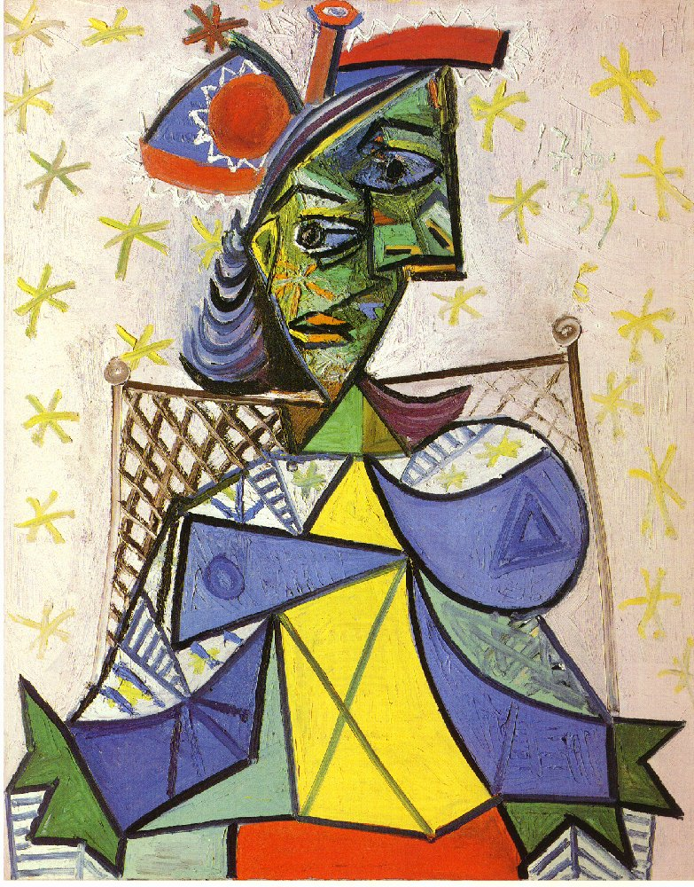
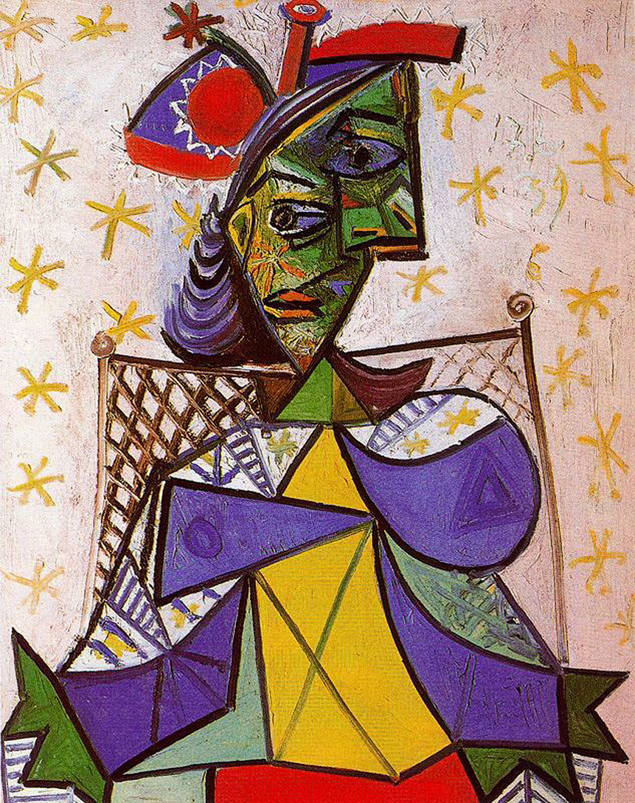
DS Lord and savior- kaggle
Combine a handful of datasets
Shotty datasets lots of duplicates
Different photographs of same photo
Classes ranged from 89-1700+
Cleaning and Augmentation was required

Slide 8
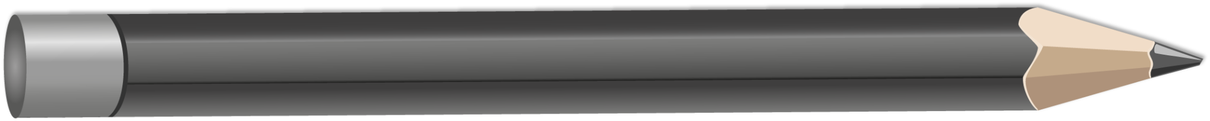
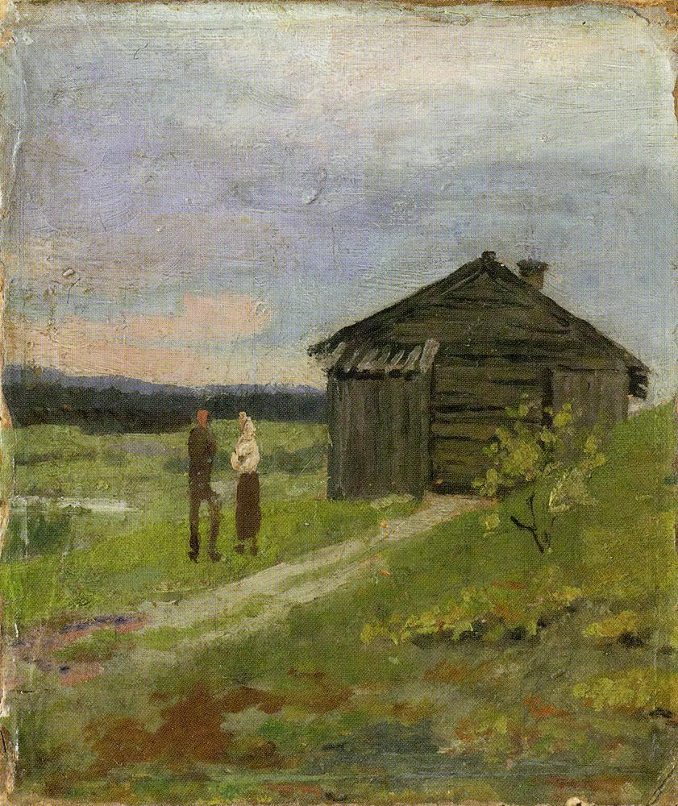
Model Architecture Overview

Slide 9
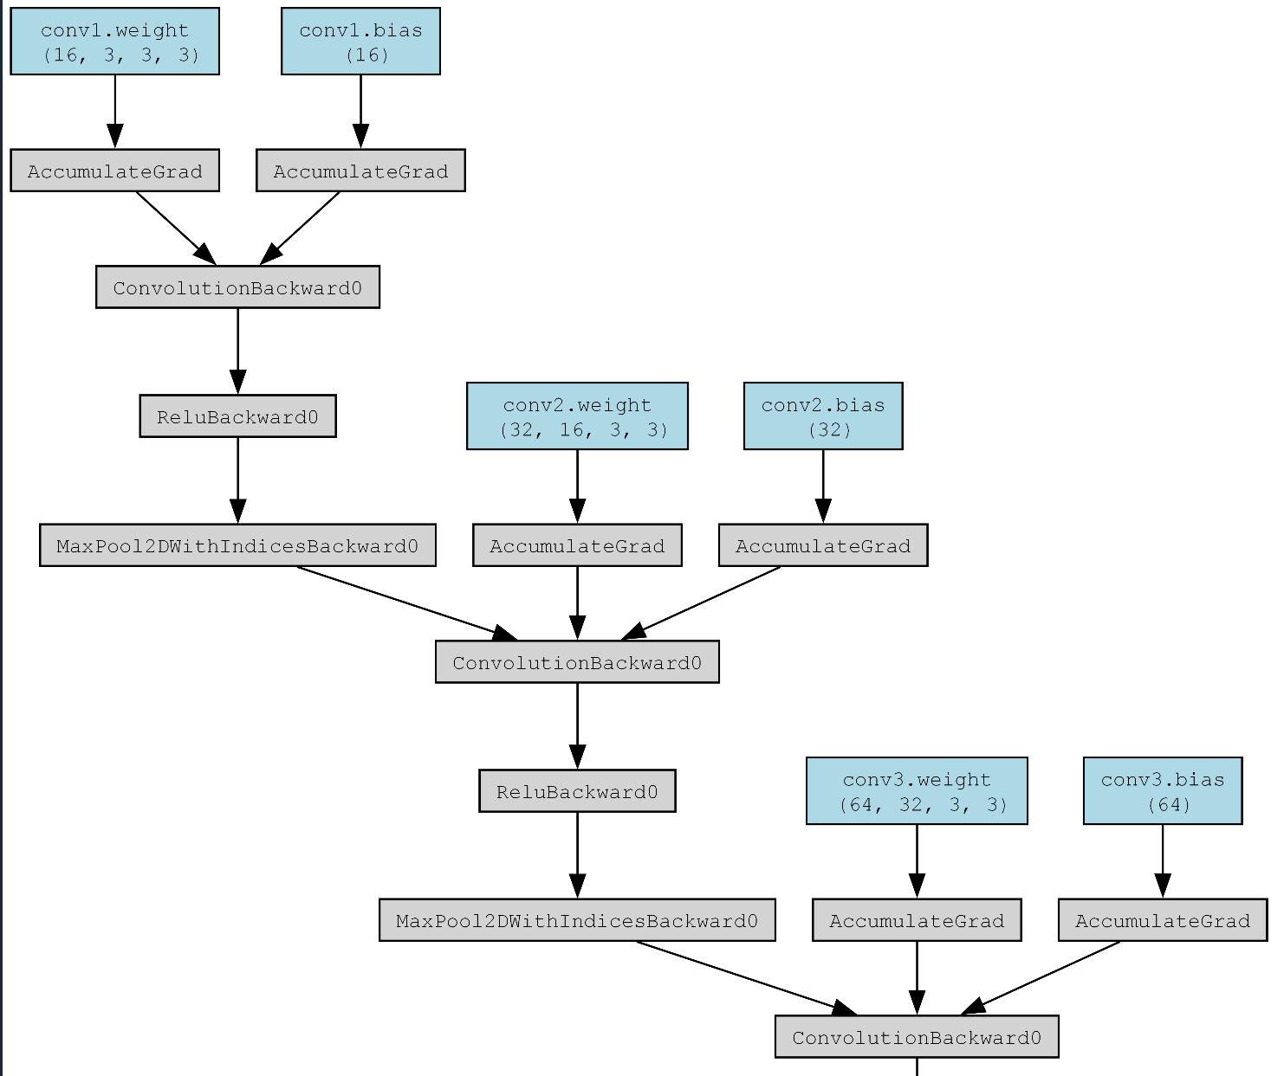
3 Convolutional layer
First 3 Inputs (RGB), 16 Outputs
Second 16 In, 32 Out
Third 32 In, 64 Out
RELU for improving accuracy in complex patterns
Max Pooling for keeping important features while ignoring the ones with little relevance

Slide 10
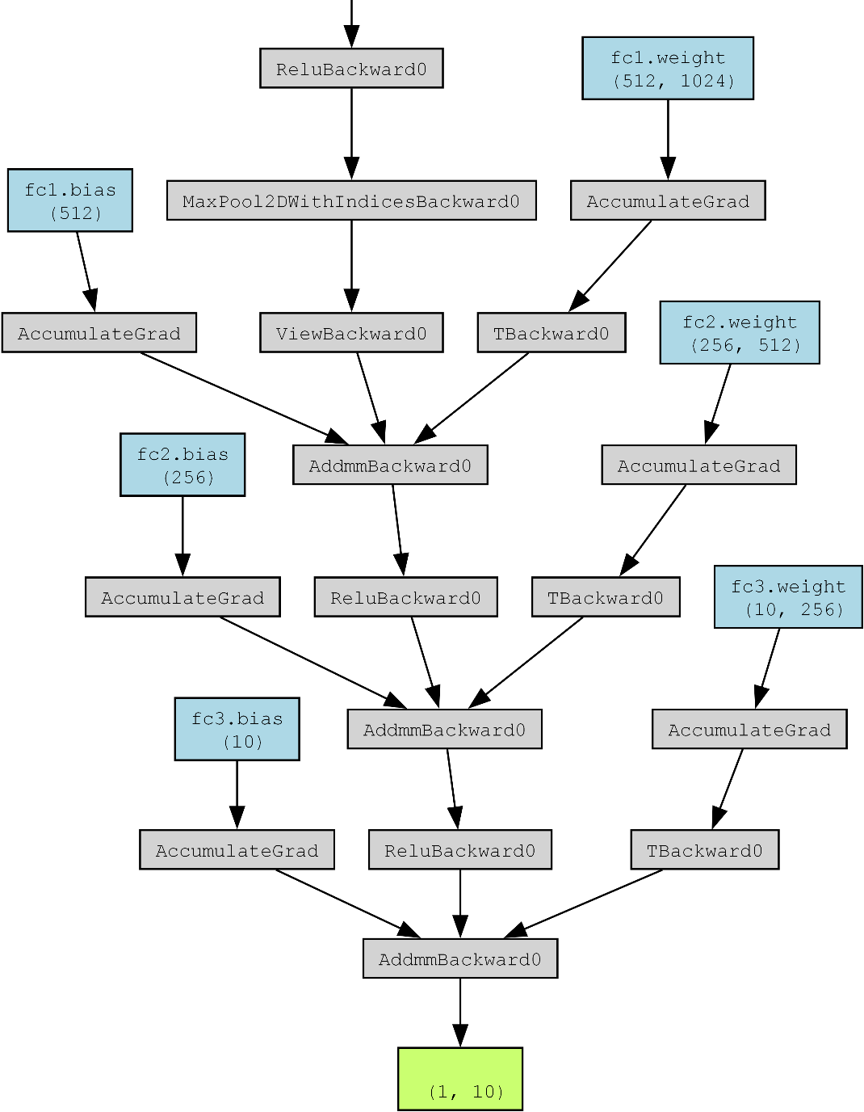
3 Fully connected layers
First has 512 neurons
Second 256
Third 10 (number of classes)

Slide 11
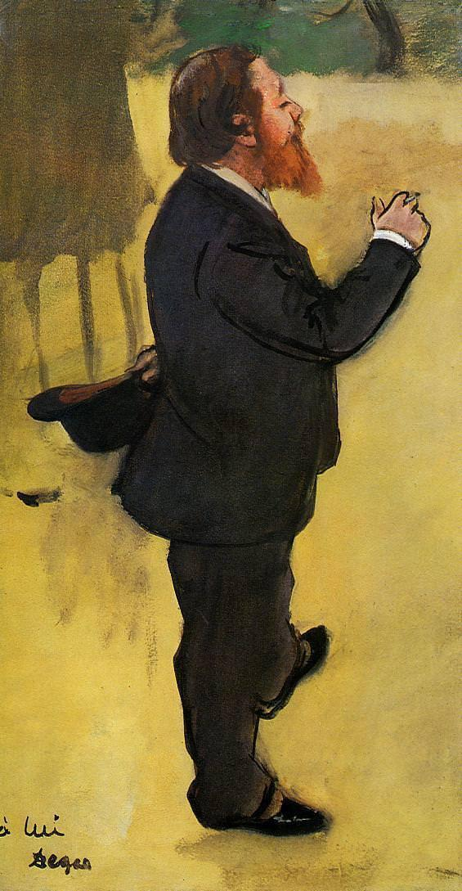
Training the Model

Slide 12
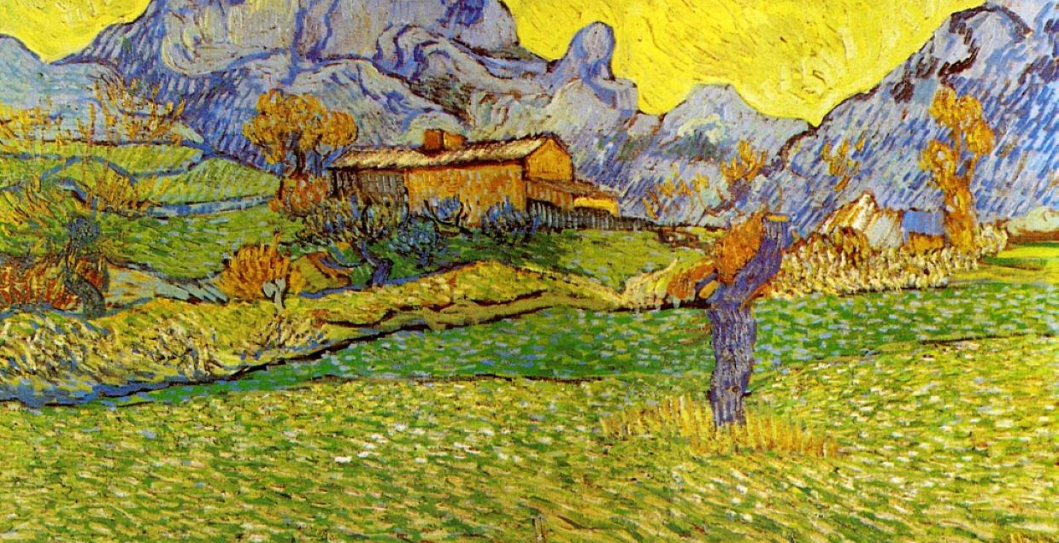
Initial Run
* Warhol -> 182
* DaVinci -> 205
* Monet -> 498
* Renoir -> 498
* Gogh -> 650
* Rembrandt -> 655
* Degas -> 703
* Dali -> 740
* Picasso -> 992
* Munch -> 1765
* 50% accuracy, only guesses Munch
First test was wonky
Used full dataset w/ 512x512 res
2 epochs
Reduced class size to 180
Accuracy was at 13%

Slide 13
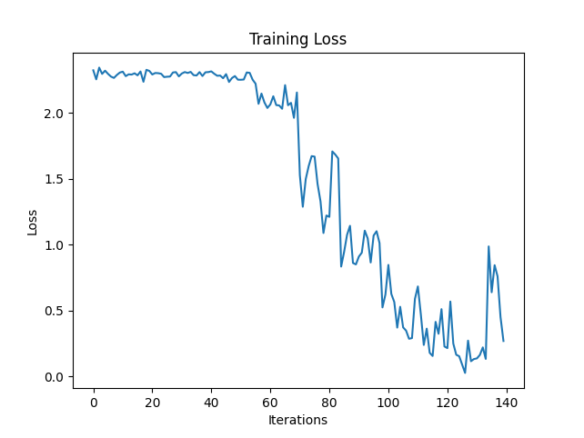
High Resolution
Toyed with epoch/batch/resolution
Couldn’t exceed 20%
Though higher res = more info
Resolution too high for dataset size
Trying to adjust 250,000 weights on 2000 training images

Slide 14
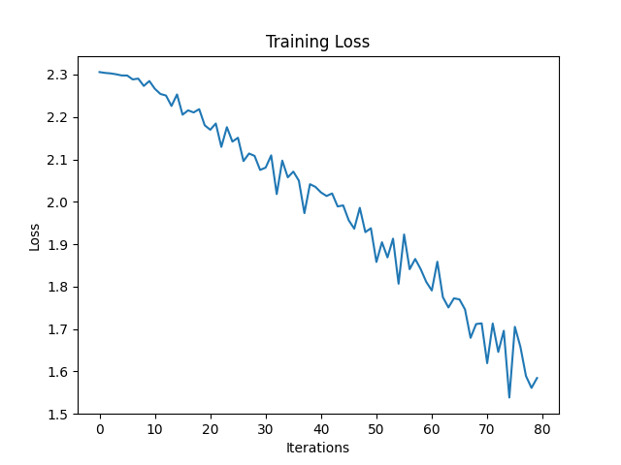
Low Resolution
Proceeded to lower resolution from 512x512 to 32x32
Started immediately learning
Decreased computation time
Retrain model much quicker
Achieving average ~30% accuracy

Slide 15
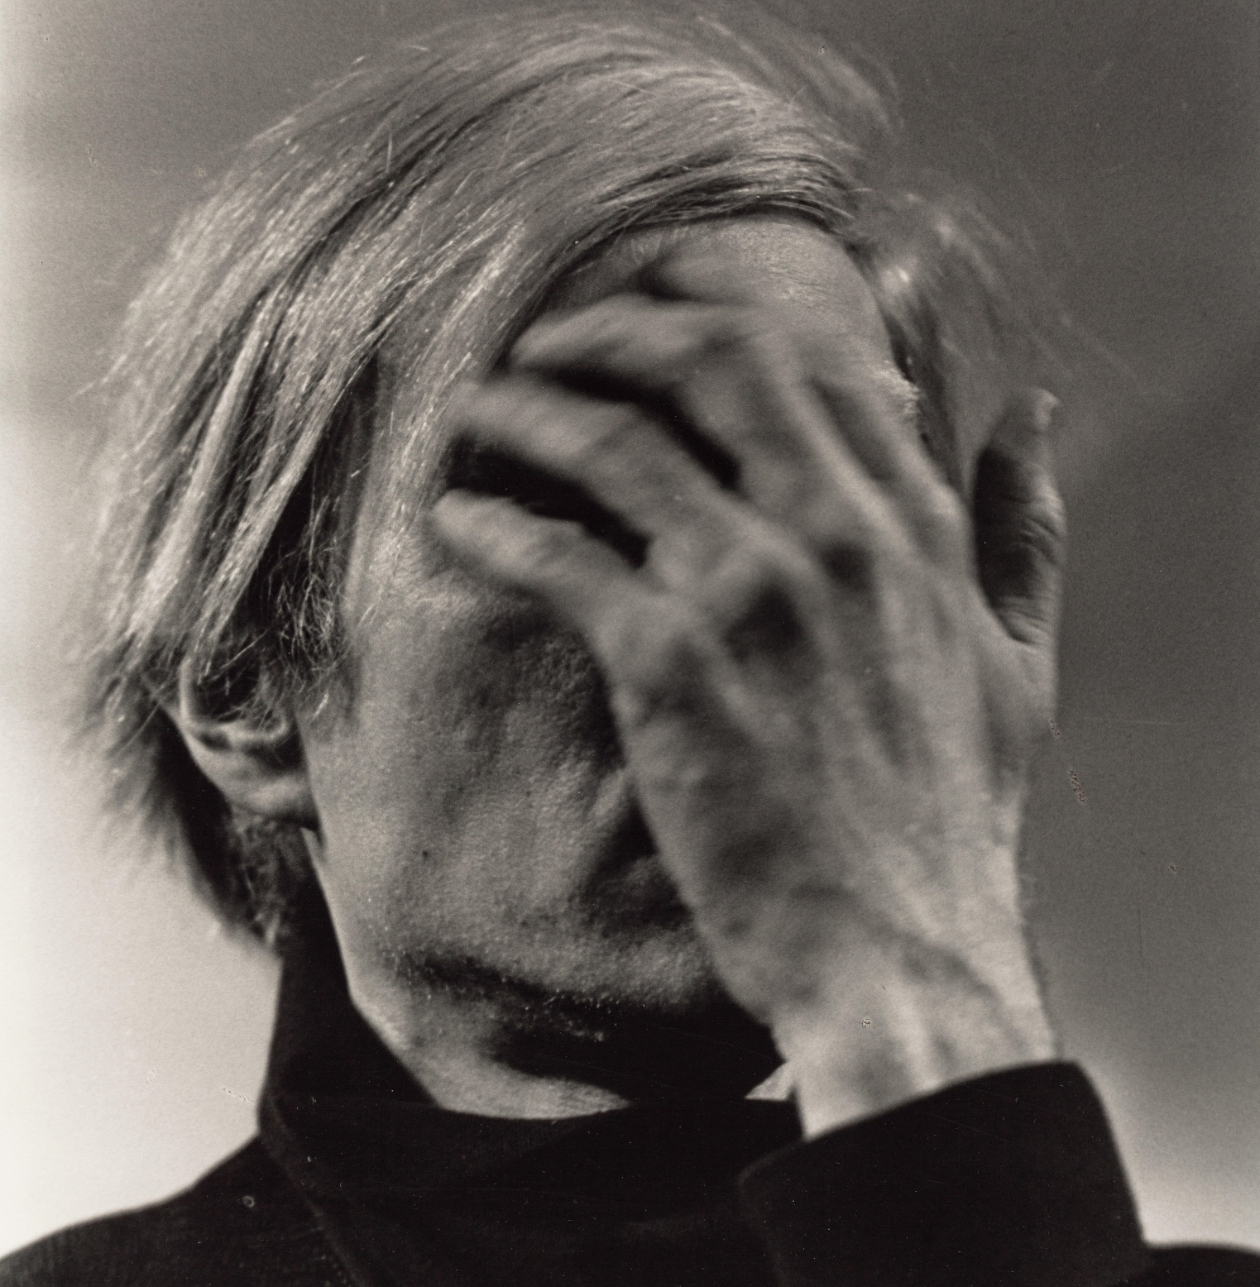
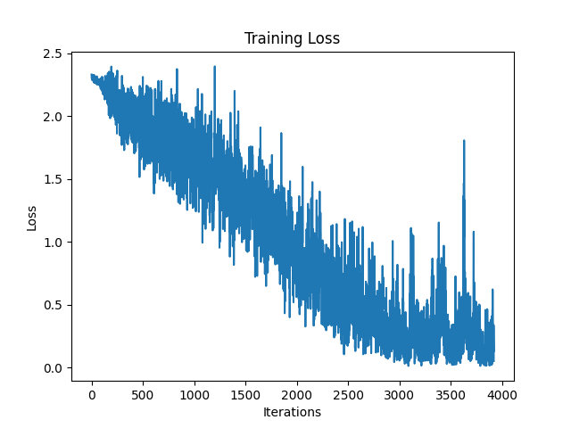
Abandoning Warhol
Attempted to find middle ground between skewed data and small dataset
Class-size 180 too small for accuracy
Class range 180-500 increased accuracy to ~35%
Picked random artist to stop guessing
Other classes ~40-55%
Abandoned class ~3%
Sweet spot x2 min smallest class size ~%35 + no class below random

Slide 16
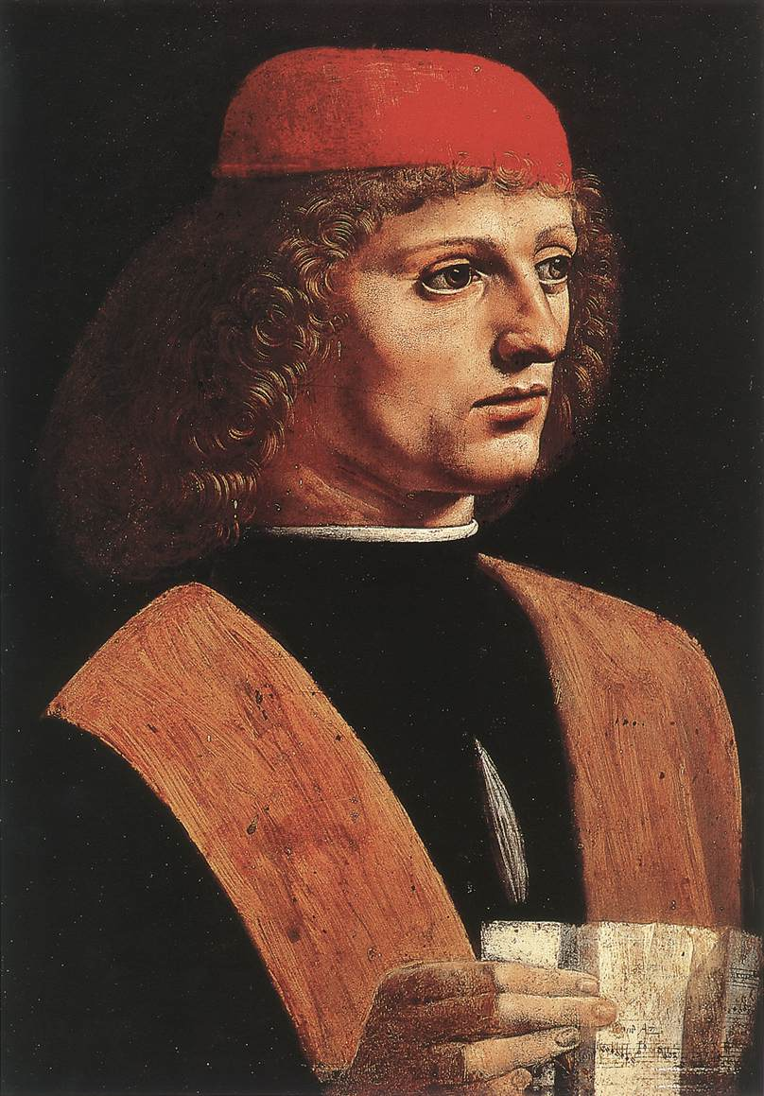
Final Model

Slide 17
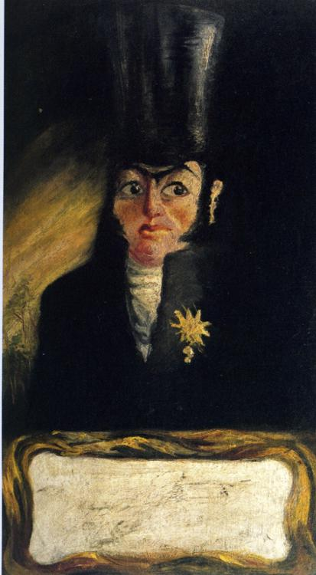
Final model Parameters
Epochs: 10
Batch Size: 20
Class Size(+augmented): 180 (augmented 2 times -> 540
Learning Rate: 0.01
Resolution Size: 32x32

Slide 18
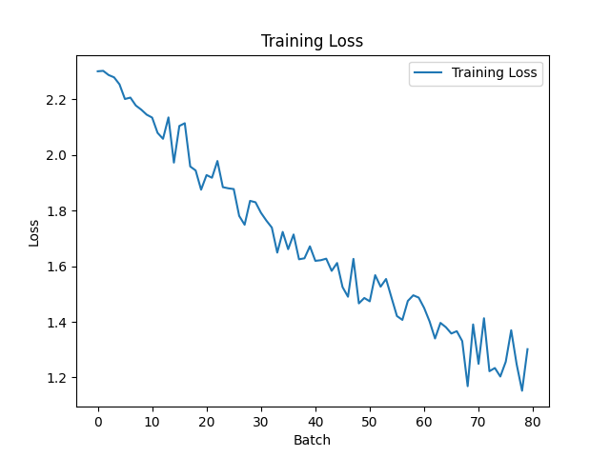
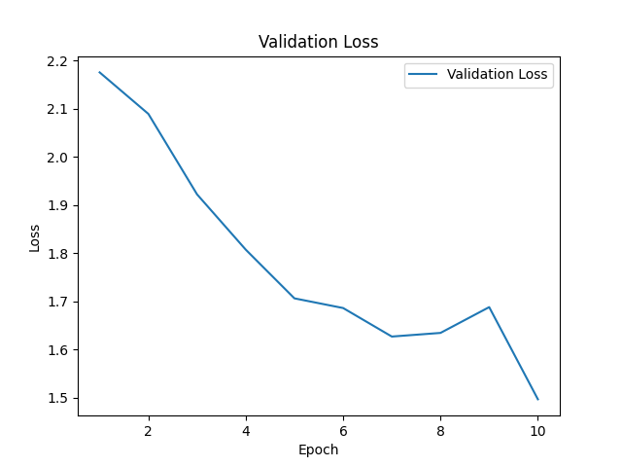
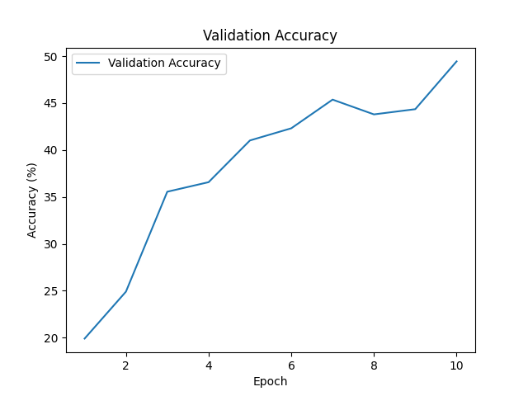
Training Graphs
Training Loss
Validation loss
Validation Accuracy

Slide 19
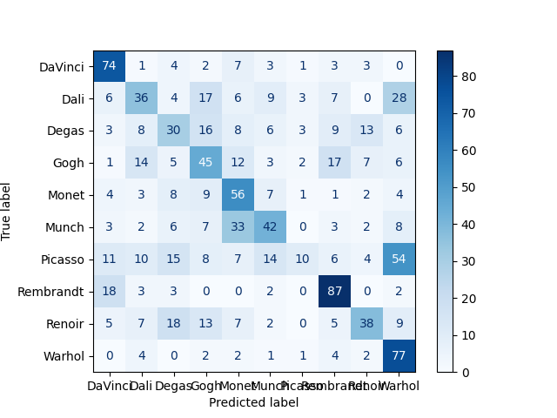
Confusion Matrix

Slide 20
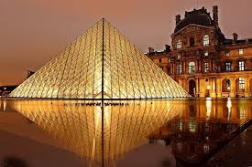
Moving Forward
Tweak model for higher accuracy
Connect to hundreds of Museums API’s
Gather enough data for higher resolution
Increase class size for more artists
Embed text reader for signature/date
Create frontend/Ui market to museums/art students/amateur collectors

Slide 21
Demo

Slide 22
Thank you
Questions?

